Slide 1

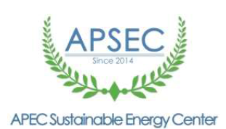
Government of North Sulawesi
Regional Planning and Develompment Board
THE CHALENGGES AND OPORTUNITIES TOWARDS SUSTAINABLE CITIES
IN NORTH SULAWESI INDONESIA
by :
Ir. Jenny KAROUW, MS
Head of
Regional Planning and Development Board,
North Sulawesi Province, INDONESIA
Workshop on the APEC Cooperative Network of Sustainable Cities – 6th APEC Workshop on Sustainable Cities, Tianjin PRC, December 9th, 2021
(Online event co-organized by APSEC CNSC and Manado State Polytechnic)
Theme: Green Finance for Sustainable Urban Energy

Slide 2
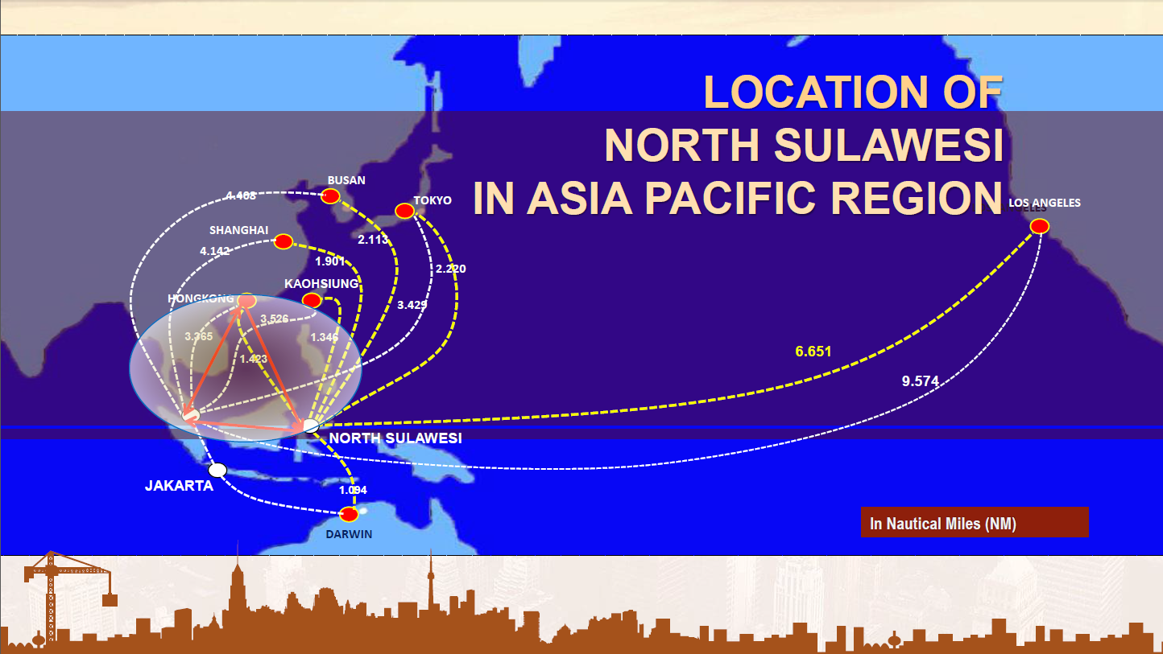

Slide 3
Green Development, global warming and energy transition
Green Development : Green development is a real estate development concept that carefully considers social and environmental impacts of development. It is defined by three sub-categories: environmental responsiveness, resource efficiency, and community and cultural sensitivity.
Global warming is the unusually rapid increase in Earth’s average surface temperature over the past century primarily due to the greenhouse gases released by people burning fossil fuels.
The International Renewable Agency (Irena) defines the energy transition as a path to the transformation of global energy that was previously based on fossil fuels into green energy that produces no carbon and is environmentally friendly. The energy transition has the ultimate goal of reducing greenhouse gas emissions from the energy sector to limit climate change.

Slide 4
BEST PRACTICES SUSTAINABLE CITIES for
GREEN DEVELOPMENT IN NORTH SULAWESI PROVINCE
Tomohon City : Prioritizing services to the community in the form of internet of things (IoT), where the government provides facilities such as digital system for population identification documents ( ID), free wifi services for all devices in every village. Besides, in cooperation with City Women Association (PKK) in managing household waste into eco enzymes as a zero waste effort but also useful as organic disinfectant and educated the women and disseminated to the community to reduced the using of electrical appliances for energy efficiency.
.
Manado City : waste management for biogas-based on energy developed in urban and sub-urban areas, PV-diesel energy hybrid program on Bunaken island and its surrounding.
”
Bitung City : adopt the principles of LCMT in Industrial Special Economic Zone ( SEZ) throughout the Urban area, namely providing easier services and access to clean energy
Kotamobagu City: digitization of population administration, health services, and land ownership by the community. The city has a sustainable communal garbage dump which is separated in several part (wet, dry n plastics) Likewise, the city government is manage in providing a communal Sanitation and Sewage Treatments
.
Referring to the Midle Term Development Planning of North Sulawesi (RPJMD) priority program 2021 - 2026, as well as the achievements of Sustainable Development Goals (SDGs), especially the 7th and 11th goals. The cities of Manado, Bitung, Tomohon and Kotamobagu currently prioritize services to the community based on the Internet of Things (IoT) such as digitalization and development that prioritize environmental balance, resource efficiency, as well as local community and cultural sensitivities.

Slide 5
THE CHALLENGES AND OPORTUNITIES
towards sustainable development goals especially no 7 and 11
Limited access to clean energy sources for MSMEs producers, namely women and local communities driving economic recovery in the C-19 pandemic era both in urban and remote areas
Generally, the City Government does not yet have a General Energy Planning Document

Slide 6
THE CHALLENGES AND OPORTUNITIES
towards sustainable development goals especially no 7 and 11
North Sulawesi has a huge potential of Renewable Energy sources such as Geothermal, Hydro, Solar, and Wind
North Sulawesi has a huge potential of Renewable Energy sources such as Geothermal, Hydro, Solar, and Wind supported by the existence of North Sulawesi engaged with Cooperative Network of Sustainable Cities – APEC

Slide 7
Solution
Encourage the establishment of infrastructure and skilled of human resources in the field of hybrid PV-diesel energy in order to use clean energy that is easily accessible by MSMEs for economic recovery due to the C-19 and other variants - pandemic
Realization of the North Sulawesi Regional Energy General Plan Documents year 2022-2027 to become the main reference for the cities and regencies in preparing training modules that support efforts to accelerate energy transition

Slide 8
Closing
Training modules in the field of clean and affordable energy management such as hybrid solar and diesel energy must be immediately prepared to meet the needs of MSMEs producers, namely women and local communities in urban and or rural areas in economic recovery efforts in the C-19 and other variants pandemic era
In the preparation of the Regional Energy Development Planning Document of North Sulawesi Province 2022 - 2027 with the transition energy as back bone should including explicitly , requires consideration and input of domestic and foreign experts (APSEC and partners) who could accelerated in making of the document and to be implemented immediately.
We are pleased in welcoming the collaboration and assistances both Financial and Technical Assistance (TA)

Slide 9
THANK YOU

