Slide 1
Engineering the Energy Transition in Cities – How to Increase the Role of Green Finance
Prof. Steivan Defilla, President Assistant,
APEC Sustainable Energy Center Tianjin, China
6th APEC Workshop on Sustainable Cities, Tianjin, 9 December 2021

Slide 2
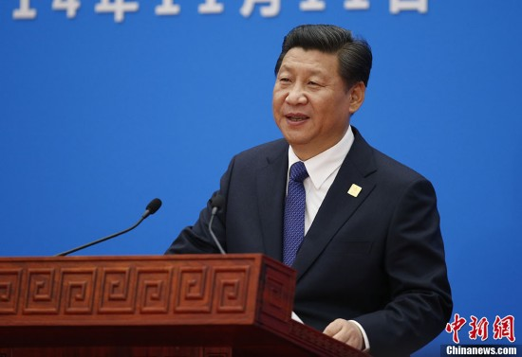
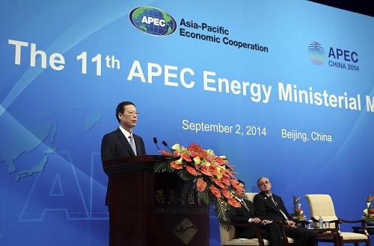
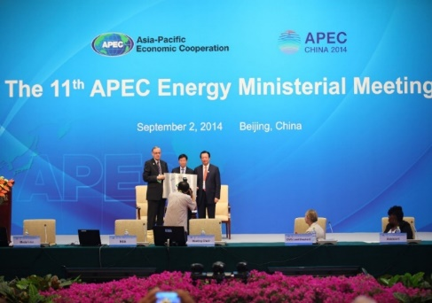
APEC Sustainable Energy Center APSEC
APEC Sustainable Energy Center (APSEC) was established at the 11th APEC Energy Ministerial Meeting in 2014, and mentioned in the 22nd APEC Leaders‘ Declaration. It is a major achievement of the Chinese government responding positively to the initiative of APEC leaders to participate in energy cooperation in APEC region.
Sep. 2014
11th EMM, Beijing Declaration, China
Nov. 2014
22nd APEC Leaders’ Declaration
Oct. 2015
12th EMM, Cebu Declaration, Philippines
Nov. 2015
23rd APEC Leaders’ Declaration

Slide 3
APSEC Mission
To promote pragmatic cooperation on sustainable energy development among APEC economics;
To act as National Energy Administration’s think-tank on conducting strategic research and international cooperation in the field of sustainable energy development
CCT Pillar Program
Clean Coal Technology
CNSC Pillar Program Cooperative Network of Sustainable Cities
ETS Pillar Program
Energy Transition Solutions
Events:
Two Workshops
The Annual Forum

Slide 4
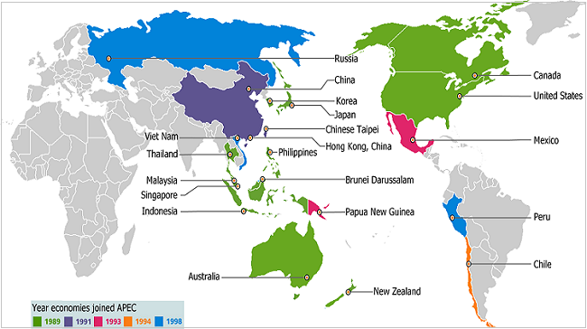
Asia Pacific Economic Cooperation (APEC)
Created in 1989 in Canberra
21 member economies
38% of world population
42% of global terrestrial surface
47% of world trade
60% of global GDP
62% of global CO2 emissions
Rotating annual presidency
APEC-Secretariat in Singapore
Energy Working Group with several Sub-groups and two Research Centers: APSEC in China and APERC in Japan

Slide 5

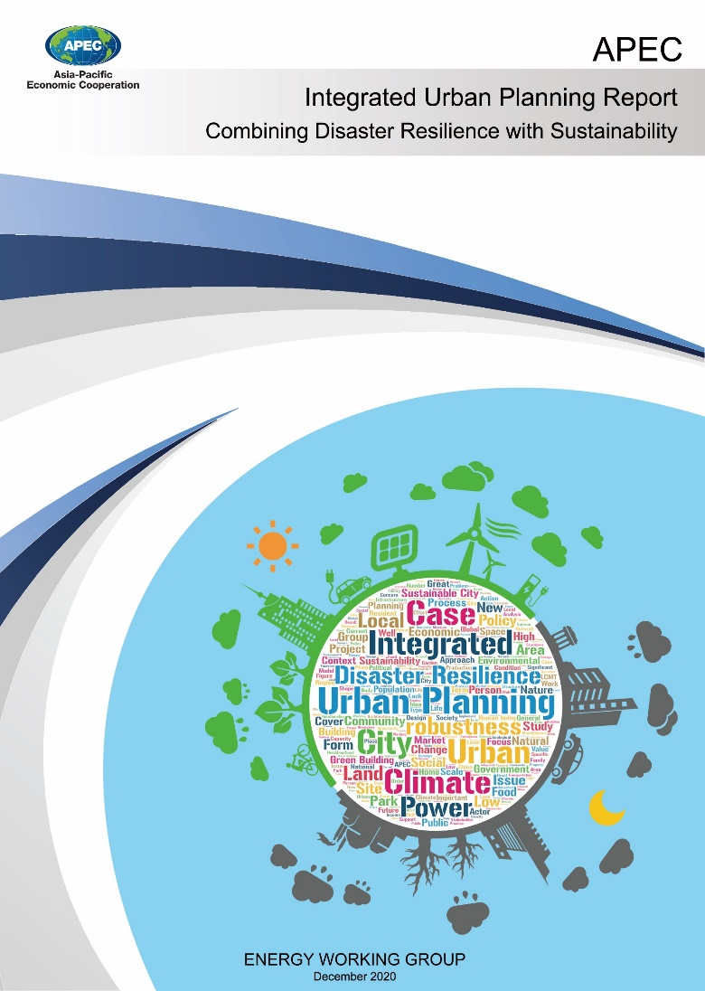
APEC Reports on Sustainability and Disaster Resilience
Sustainable Urban Development Report
Electronic version https://www.apec.org/Publications/2019/04/APEC-Sustainable-Urban-Development-Report---From-Models-to-Results
Integrated Urban Planning Report
Electronic version https://www.apec.org/Publications/2021/03/APEC-Integrated-Urban-Planning-Report

Slide 6
Economic Measures Available to Cities
Conclusions
What is the Energy Transition
How to Catalyze Public Investments

Slide 7
IEA Landmark Reports 2021
Notes:
Landmark Report released on 18 May 2021
Combining the models of World Energy Outlook (short term) with Energy Technology Perspectives (mid- to long term)
IEA cooperated with IMF for the impacts on employment
IEA also cooperated with IIASA for emissions from land use
Is it still possible to attain the 1.5 degrees?
Answer: it is still possible, but on a narrow path; it is a «race to zero», in which many obstacles must be overcome. The main principle is: leaving no-one behind

Slide 8
Some milestones of the IEA Roadmap to 2050
Annual global clean energy investment triple to USD 4 trl by 2030
Dominated by green investment
400 milestones to be attained by 2050
From today, no need for new fossil fuel supply investments
No need for any unabated new coal fired plants
By 2030, all market-ready technologies are fully rolled out
By 2030, all prototypes new technologies are market-ready
By 2030, all new buildings are zero-carbon ready
By 2035, no new sales of internal combustion engine cars
By 2040 the global power system is carbon free in net terms
By 2050 six times more jobs created than jobs that will be lost
By 2050 global GDP to have additional +0.4% annual increase, resulting in adding an economy of the size of Japan to the world
BUT: Take special care to the regions having to quit fossil energies; leave no one behind
https://www.iea.org/reports/net-zero-by-2050

Slide 9
Comparison between 18 IPCC scenarios and IEA-NZE
The IEA-NZE has the lowest level of energy-related CDR and bioenergy of any scenario that achieves net-zero energy sector and industrial process CO2 emissions in 2050
CCUS = carbon capture, utilisation and storage; CDR = carbon direct removal;
TES = total energy supply;
TFC = total final consumption. Energy‐related CDR includes CO2 captured through bioenergy with
CCUS and direct air capture with CCUS and put into permanent storage.

Slide 10
Clean Energy Investment to Leapfrog
Total global annual energy investment surges to USD 5 trillion by 2030, adding an extra 0.4 percentage point a year to annual global GDP growth, based on joint IEA/IMF analysis.
Governments have a key role in enabling investment‐led growth and ensuring that the benefits are shared by all.

Slide 11
2020
33.9 Gt total emissions
Power > industry > transport > buildings

Slide 12
2030
21.1 Gt total emissions
Industry > power > transport > buildings

Slide 13
2035
12.8 Gt total emissions
Industry > transport > power > buildings

Slide 14
2040
6.3 Gt total emissions
Industry > transport > buildings > power (is negative)

Slide 15
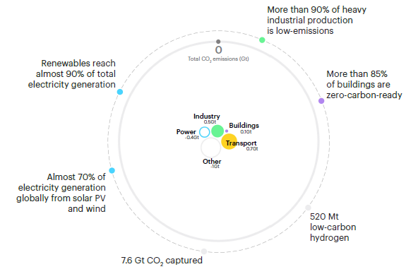
2050
Net Zero Gt total emissions
Transport > industry > buildings > power (is negative)

Slide 16
Difference between gross and net carbon neutrality
BECCS = bioenergy with carbon capture and storage; DACCS = direct air capture with carbon capture
and storage. BECCS and DACCS includes CO2 emissions captured and permanently stored

Slide 17
Fuel shares in selected applications
Indirect renewables = use of electricity and district heat produced by renewables.
Other low‐carbon = nuclear power, facilities equipped with CCUS, and low‐carbon hydrogen and hydrogen‐based fuels.

Slide 18
Development of bioenergy

Slide 19
Annual Average Capital Investments (all energy)
Capital investment in energy rises from 2.5% of GDP in recent years to 4.5% by 2030; the
majority is spent on electricity generation, networks and electric end-user equipment

Slide 20
Make the 2020s the decade of massive clean energy expansion

Slide 21
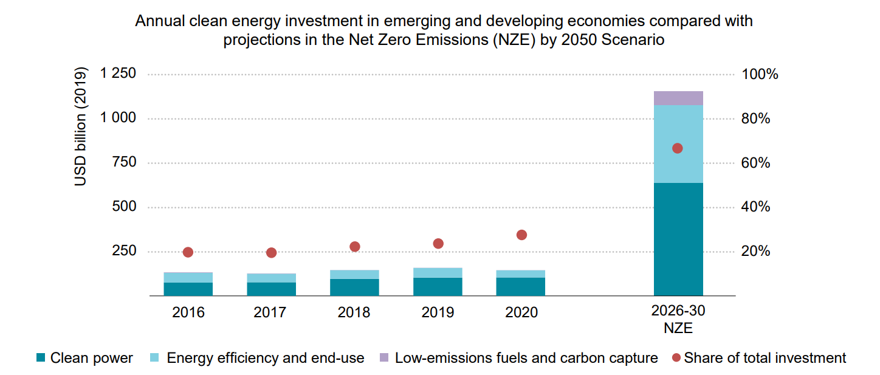
Clean Energy Investment in the Emerging and Developing World
Reducing emissions in emerging economies costs half less than in developed economies
Emerging economies receive only 150 bln USD clean energy investment a year, should increase to 1 trl USD per year (sixfold increase)
The required quantum leapfrog will require all available finance instruments to be successful

Slide 22
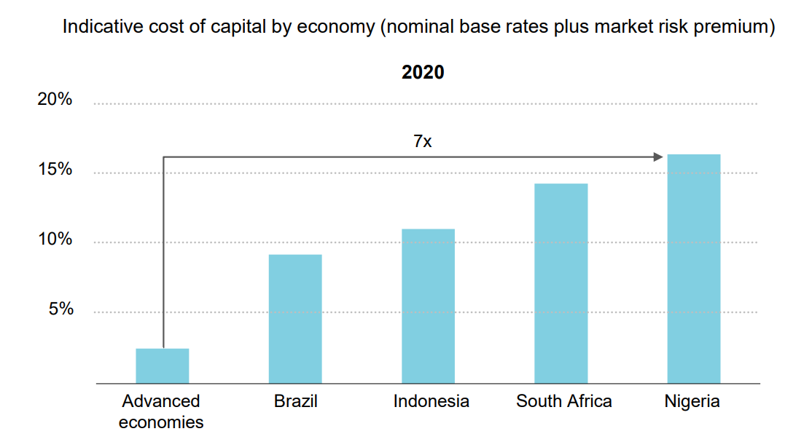
Comparison of Capital Cost by Level of Development
Cost of raising capital in emerging and developing economies is up to 7 times higher than in advanced economies

Slide 23
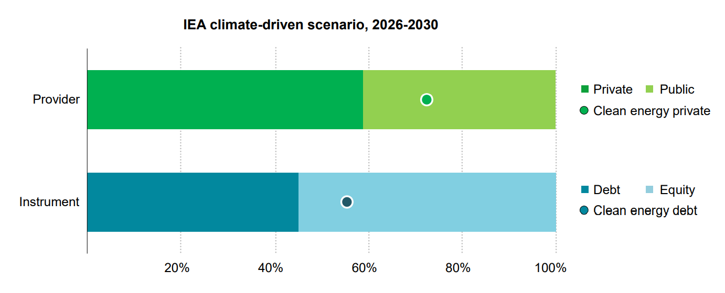
Debt Equity Mix for Energy vs Clean Energy
Clean energy relies more on private funding than average energy
Clean energy relies more on debt than average energy
Role of public sector and especially public equity not sufficient

Slide 24
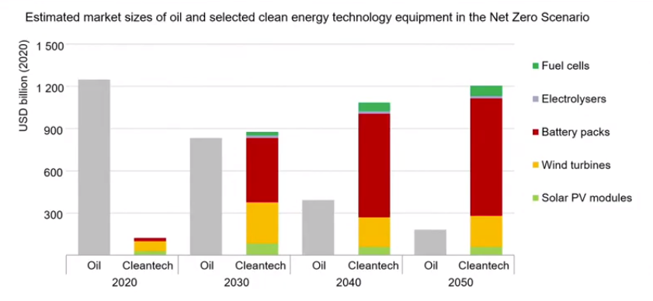
New Global Energy Economy is Emerging
Key role for energy storage
IEA WEO 2021

Slide 25
Economic Measures Available to Cities
Conclusions
What is the Energy Transition
How to Catalyze Public Investments

Slide 26

Cities as regulators
2016: Habitat III Conference, Quito, Ecuador, translating SDGs to local level
Since UN Earth Summit 1992: Local Agenda 21 (LA21):
Local Agenda 21 (LA21) is a voluntary process of local community consultation with the aim to create local policies and programs that work towards achieving sustainable development.
6,500 local governments in 116 economies are committed to or are undertaking a Local Agenda 21 process
2014: Carbon Neutral Cities Alliance
Launched in Copenhagen in June 2014 and launched by Mayors of 17 international cities across nine economies
Achieve aggressive long-term carbon reduction goals
https://unfccc.int/news/carbon-neutral-cities-alliance
C40 declaration on fossil fuel free streets:
https://www.c40.org/declarations/green-healthy-streets-declaration/
https://unhabitat.org/sites/default/files/2019/05/nua-english.pdf

Slide 27
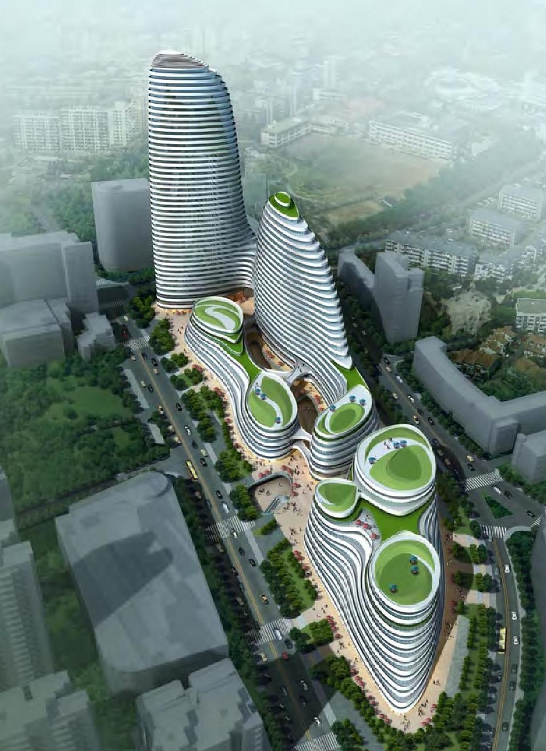
Cities as planners
Since 1950s: HOPSCA (Hotel, Office, Parking, Shopping Mall, Convention & Apartment) is a modern development concept of “Integrated City Within City”.
Land planning as first planning area
19th & 20th century zoning

Slide 28
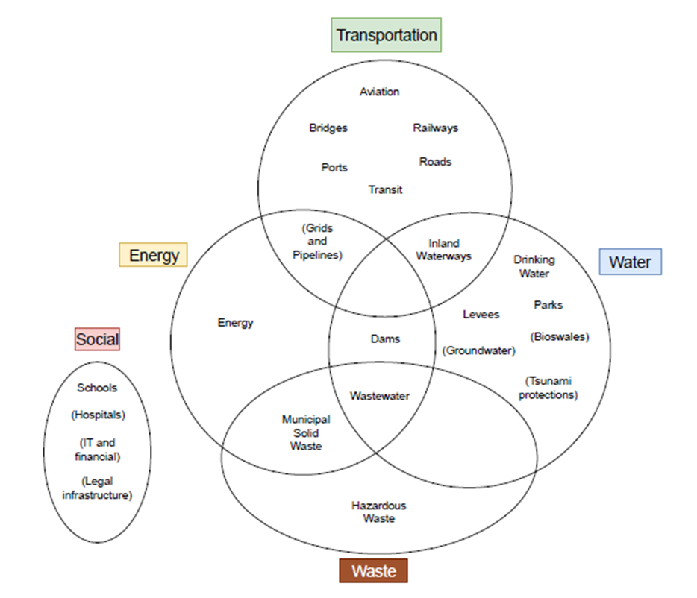
Cities as infrastructure operators
Insufficiencies of HOPSCA concept:
Not yet including some essential urban infrastructures:
Universities + Science/Technology Parks, incubators for SMEs
Hi-tech industries: Pharmaceuticals, computer, electronic and optical products);
Possibly Medium Tech industries: Other transport equipment, motor vehicles, trailers, semi-trailers, machinery, chemicals, electrical equipment)
Missing connection to transit systems
Not providing for a certain percentage of affordable housing, see UN Habitat Principles of Sustainable neighbourhood planning,
https://unhabitat.org/a-new-strategy-of-sustainableneighbourhood-
planning-five-principles

Slide 29
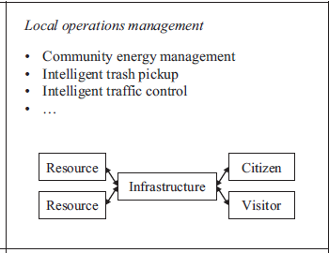
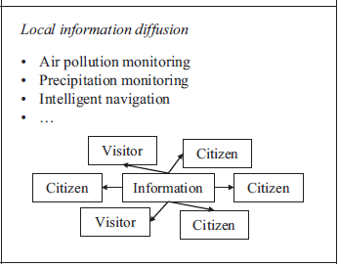
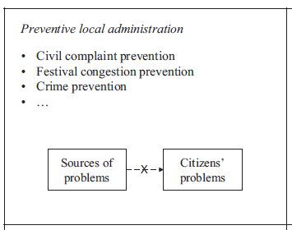
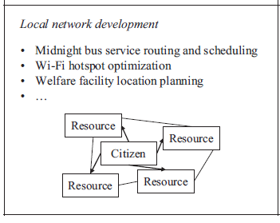
Infrastructures as Creators and Users of New Smart Processes
Data Users
Local companies and government
Citizens and visitors
Four reference cases BG2BG, BG2C, C2BG, C2C, depending on data source and data users
Relevant for energy transition: e.g. Smart energy management, smart waste pickup, midnight bus service routing
BG2C
Local companies and government
BG2BG
Data Source
C2BG
C2C
Citizens and visitors
Chiehyeon Lim and others: https://doi.org/10.1016/j.cities.2018.04.011

Slide 30
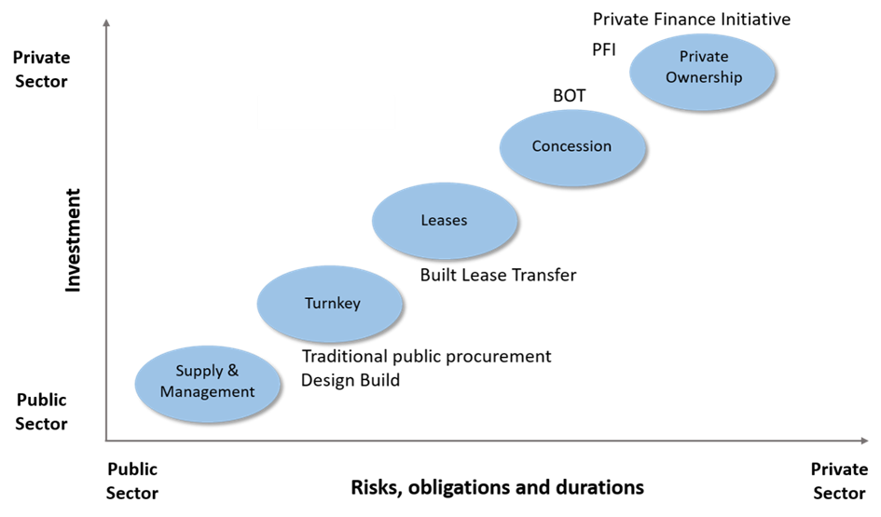
Cities as PPP partners and Project Financers
PPP uses the comparative strength of both, public and private partners, respectively:
Private partners to bring new technologies and capital
The bigger the role of the private sector, the bigger the financial input (including risks and obligations) taken by the private sector.
PPP are essential for cities to attract private investment and hence to catalyze public investment

Slide 31
Cities as Consumers and Investors: GPP and ESG
1) GPP Green Public Procurement (supplier relations)
Common example: Portfolio standards
2) ESG Environmental, Social, Governance (investor relations)
Governance
E.g. leadership, executive pay, audits, internal controls, and shareholder rights

Slide 32
Taxonomy: Towards Defining Sustainable Economic Activities
9 March 2020, the EU Technical Experts Group published its final report on EU taxonomy. https://ec.europa.eu/info/files/200309-sustainable-finance-teg-final-report-taxonomy_en
22 June 2020: the EU Commission published the EU Taxonomy Regulation: https://ec.europa.eu/info/law/sustainable-finance-taxonomy-regulation-eu-2020-852_en
The Taxonomy Regulation establishes six environmental objectives
Climate change mitigation
Climate change adaptation
The sustainable use and protection of water and marine resources
The transition to a circular economy
Pollution prevention and control
The protection and restoration of biodiversity and ecosystems
Detailed list published on 4 June 2021
Detailed list to be published in 2022

Slide 33
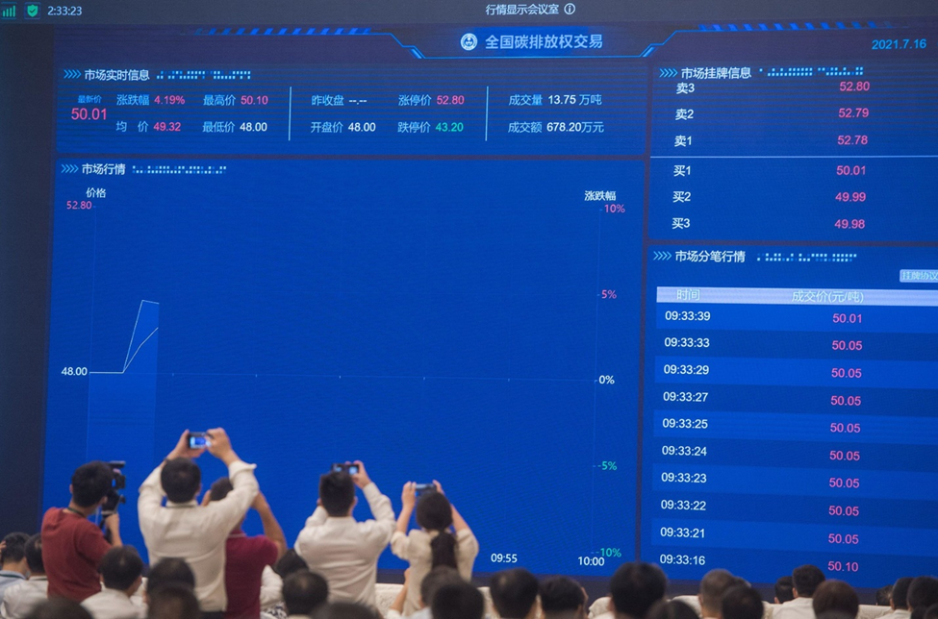
Economic Instruments: Example of Economy scale Carbon Market
China started emissions trading on 16 July 2021.
Opening day: price 48 yuan/t closing price 52.8 yuan/t.
First two weeks about 6 million t of allowances traded, price of about 300 million yuan.
As of 5 August, prices between 53–59/t.

Slide 34
Setting up/participating in Voluntary Carbon Markets
Asia highest volume and highest growth
Year 2021 likely to set an all-time high value
Examples for local carbon markets see https://www.cityforestcredits.org/
Forest Trends Association’s Ecosystem Marketplace, 2021

Slide 35
Feed-in-Tariffs (FIT)
15 – 20 year contract between a renewable energy producer and utility. Tariffs depend on technology (PV, wind, ….) and size of production installation.
Three forms
Fix price FIT
Degressive FIT, taking into account technological progress
FIT premium above market price, taking into account of market situation
Problem: FIT usually do not include associated storage
FIT are by far the most successful instrument of favouring renewable electricity generation.
Examples of municipal feed-in tariffs:
Anaheim/California: https://www.anaheim.net/651/Feed-In-Tariff-Program
South Africa, https://www.solarenergylife.co.za/municipal-feed-in-tariffs-on-solar-power-feedback-into-the-grid/

Slide 36
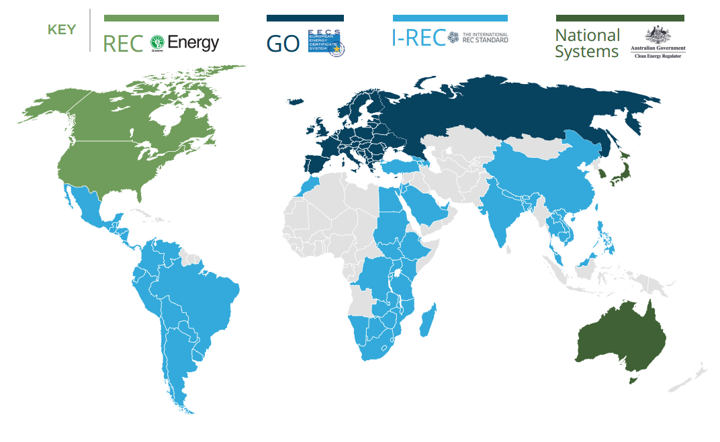
Renewable Energy Certificates REC and Guarantees of Origin GO
Renewable energy producer may emit and sell a certificate for each MWh produced.
RECs originate in America, GOs in Europe.
I-REC Standard established in 2014 in the Netherlands operates a single global registry through which energy products from renewable sources can be certified through the electricity supply chain.
Natural Capital Partners

Slide 37
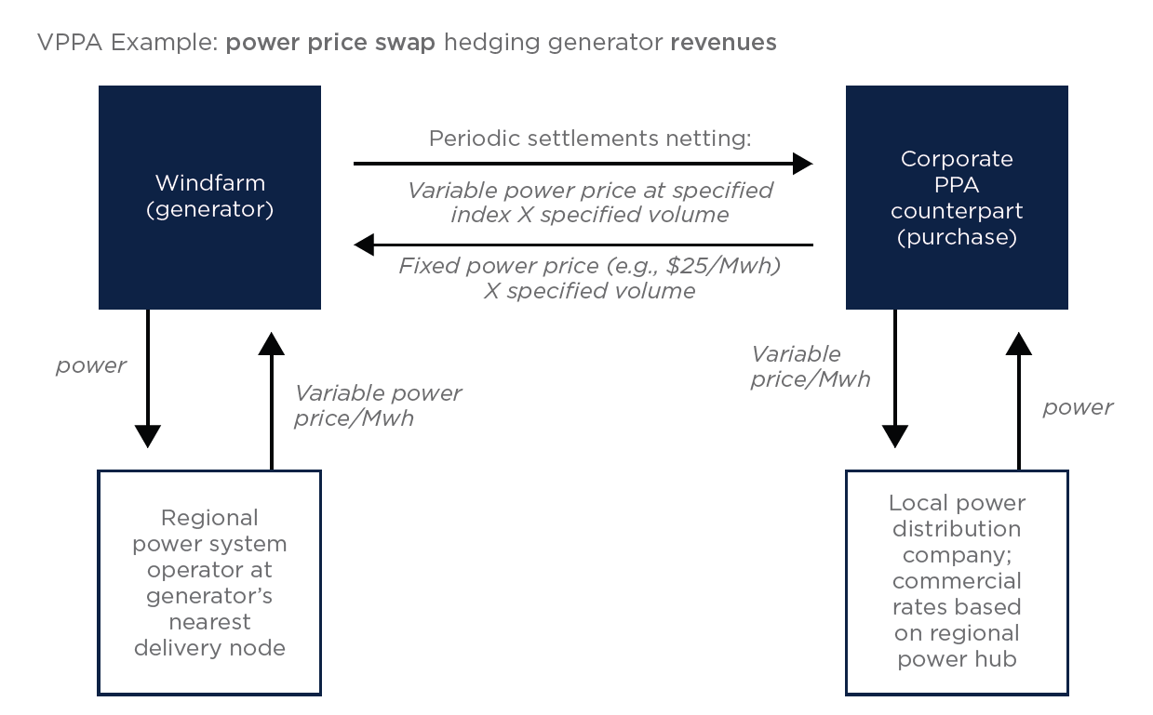
Power Purchasing Agreements PPA
Traditional Power Purchase Agreement (“PPA”) is a contract between the public and private sector parties which underpin a power sector PPP.
It is typically between a public sector purchaser "offtaker" (often a state-owned electricity utility, in jurisdictions where the power sector is largely state operated) and a privately-owned power producer.
Traditional PPA is often combined with a BOT or concession agreement.
Virtual PPA for energy transition: combined with price hedging clause
Kobus, Nasrallah, Guidera, March 2021

Slide 38
Economic Measures Available to Cities
Conclusions
What is the Energy Transition
How to Catalyze Public Investments

Slide 39

COP 26, Glasgow
General declarations and decisions: e.g. Glasgow Climate Pact 13 Nov 2021: https://unfccc.int/documents/310475
Completing the UNFCCC Rulebook, e.g. Guidance on Art. 6.2 https://unfccc.int/sites/default/files/resource/cma3_auv_12a_PA_6.2.pdf
Approx. 30 separate voluntary agreements on various topics (UK agenda):
Main page: https://ukcop26.org/the-conference/cop26-outcomes/
Coal, Cars, Cash, Trees, Methane
Bilateral agreements:
e.g. US-China: https://www.state.gov/u-s-china-joint-glasgow-declaration-on-enhancing-climate-action-in-the-2020s/

Slide 40
Climate Finance Delivery Plan Meeting the US$ 100 bn Goal
UN 2015 Addis Abbeba Action Agenda: affirmed USD 100 billion $ ODA pledge by developed economies to attain the Paris Climate Agreement goal
https://ukcop26.org/wp-content/uploads/2021/10/Climate-Finance-Delivery-Plan-1.pdf

Slide 41
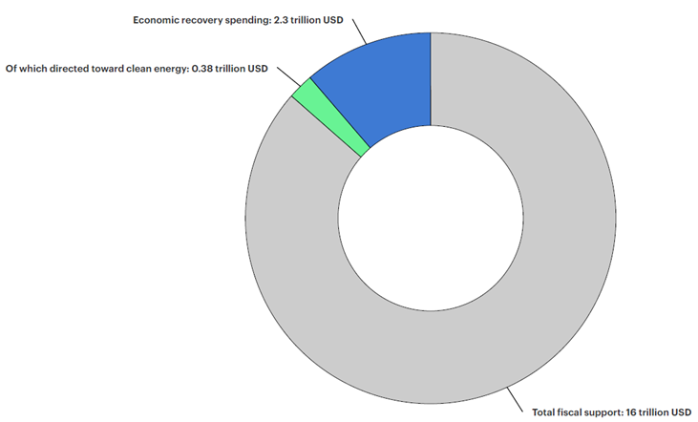
Only 2% of the World’s public financial support goes to renewables
By mid-2021, globally USD 16 trillion to address COVID-19 measures
Of these, USD 2.3 trillion directed toward economic recovery, defined as long-term projects and measures to boost growth
Of these, USD 380 billion directed to energy-related sustainable recovery
https://www.iea.org/reports/sustainable-recovery-tracker/tracking-sustainable-recoveries#abstract

Slide 42
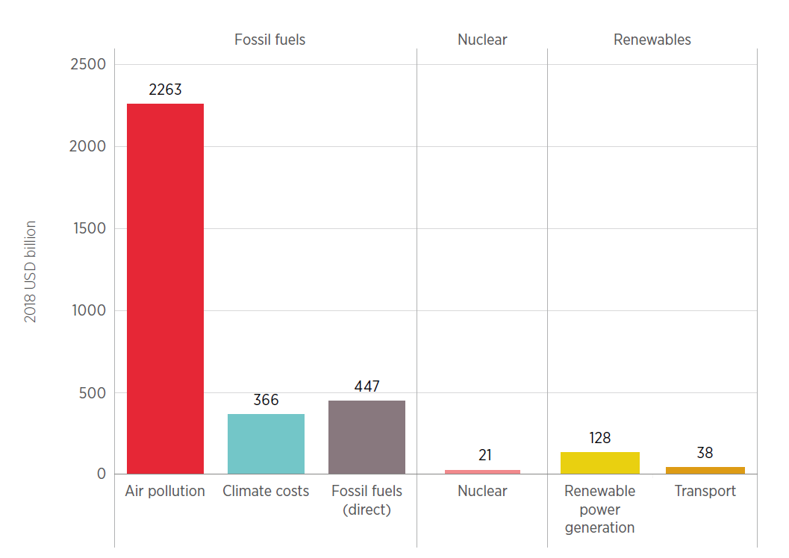
Global energy subsidies 2017
Fossil fuels still receive around four times as much direct public support as renewables; their external costs could be 8 to 10 times higher.
Fossil fuel subsidies slowly decrease by about US$ 100 billion per decade
Renewables: support measures have increases in recent times after COVID-19 stimulus packages.
https://irena.org/-/media/Files/IRENA/Agency/Publication/2020/Apr/IRENA_Energy_subsidies_2020.pdf

Slide 43
Financial Instruments: Guarantees for traditional investment
Guarantees are prime instruments to reduce risk. Provided by
governments, or by
green investment entities and
green banks.
Example: MIGA insures foreign direct investments against losses
related to:
Currency inconvertibility and transfer restrictions
Expropriation
War, civil disturbance, terrorism, and sabotage
Breach of contract
Non-honoring of sovereign financial obligations
MIGA provides dispute resolution services for guaranteed investments to prevent disruptions to developmentally beneficial projects.
https://www.miga.org/sites/default/files/2018-06/Advancing_Sustainable_Investments.pdf
Other example:
The European Investment Bank’s EIB Project Bonds Credit Enhancement and the Project Bond Initiative of 2012
https://www.eib.org/attachments/documents/project_bonds_guide_en.pdf
Objective: attract capital for the European transport, energy, information and communication networks (infrastructure).

Slide 44
Guarantees for Green Investment
Green Investment Guarantees should be adapted to cover the specific risks of green investments
Objective: attract capital for an economy-scale green investment plan .
Example: Interamerican Development Bank, 2014
“Guarantees for Green Markets: Potential and Challenges”
https://publications.iadb.org/publications/english/document/Guarantees-for-Green-Markets-Potential-and-Challenges.pdf
Not (yet) created: risk mitigation tool for solar power, https://terrawatt.org/ (1000 Billion USD scheme)
Process: Solar Risk Mitigation Initiative SRMI, launched at COP 24 in 2018 https://isolaralliance.org/work/affordable-finance-scale
Solar Deployment Guidelines + e-Tendering platform;
In force: Sweden’s state credit guarantees for investment in green industry, June 2021
Issued by Swedish National Debt Office
Covers loans > SEK 500 Mio
Guarantees up to 80% of loan
Maturity maximum 15 years
See IEA policies data base
https://www.iea.org/policies/12452-budget-2021-government-credit-guarantees-for-green-investments?topic=Renewable%20Energy

Slide 45
Insurance for Green Investments
Recent initiatives:
Net-Zero Insurance Alliance NZIA, formed in July 2021 by the 8 global leading insurers signed to
“Commit to transitioning its investment portfolios to net-zero GHG emissions by 2050 consistent with a maximum temperature rise of 1.5°C above pre-industrial levels …”,
https://www.unepfi.org/net-zero-alliance/
NZIA was convened under the UNEP Finance Initiative’s Principles for Sustainable Insurance (PSI),
https://www.unepfi.org/psi/
See also: Net-Zero Banking Alliance NZBA, created in April 2021 by 43 founding banks representing over 40% of global banking assets, https://www.unepfi.org/net-zero-banking/
Example: Insurance for environmental liability
Prerequisite: legislation must state the civil liability of an industrial enterprise for specified types of environmental damage, and the maximum amount of liability for each type of damage.
Examples: Oil spills, nuclear accidents.
Private insurers will then offer insurance coverage.

Slide 46
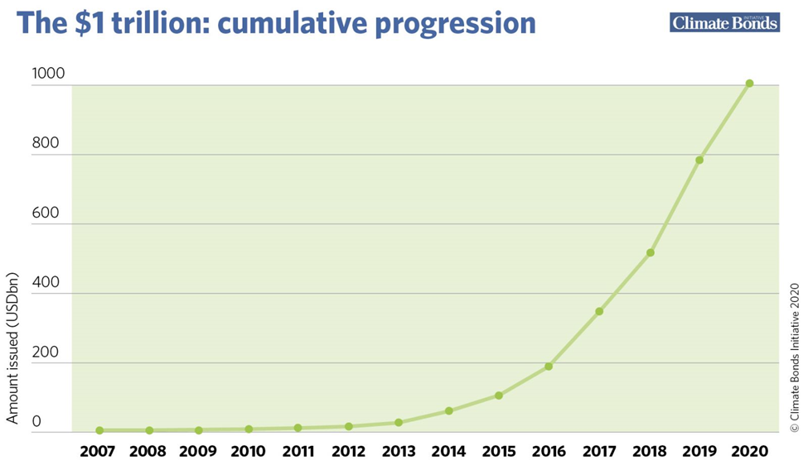
Green Bonds
Most green bonds are using general (grey) assets and earmarking them for climate and environmental (green) projects.
First issued by World Bank and EIB in 2007
2013 first green bond issued by a Swedish property company
2013 first municipal green bond issued by Massachusetts
2016 first sovereign bond (Poland)
Today >67 economies issuing green finance instruments
NB: global green finance requirement: USD 4 trl per year
Climate Bonds Initiative

Slide 47
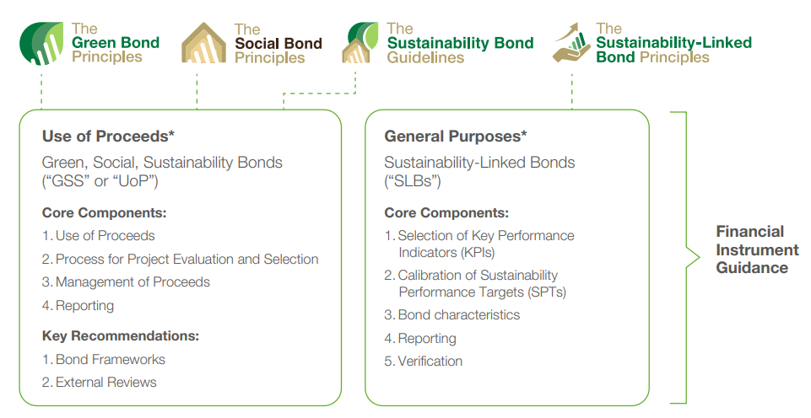
Other similar types of bonds
Green Bond Principles Voluntary Process Guidelines for issuing green bonds, 2021; 100% of proceeds to be used for the specified purpose
https://www.icmagroup.org/assets/documents/Sustainable-finance/2021-updates/Green-Bond-Principles-June-2021-140621.pdf
Reporting annually on use of proceeds

Slide 48
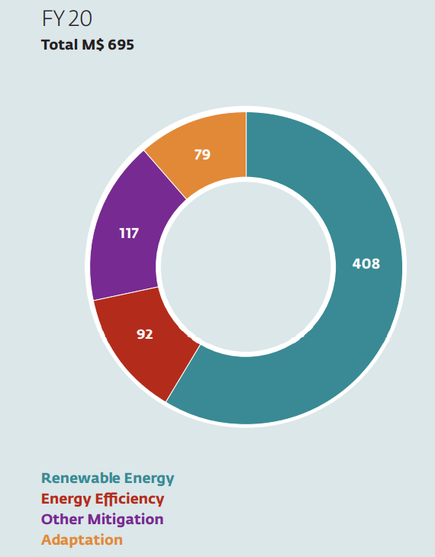
Green loans
Green loans use general (grey) assets to channel them to climate and environmental (green) projects.
World Bank’s International Finance Corporation (IFC) is today the largest provider of green loans
Loans are much smaller than bonds
Loans are done in private operation
Loans are not listed on an exchange
Green Loan Principles (Dec 2018): Voluntary recommended guidelines; 100% of proceeds to be used for the specified purpose
https://www.lma.eu.com/application/files/9115/4452/5458/741_LM_Green_Loan_Principles_Booklet_V8.pdf
Total green loans outstanding at IFC: USD 33 bln, of which only USD 1.6 bln to developing economies
New IFC green loans 2020:
Adaptation as a new major component

Slide 49
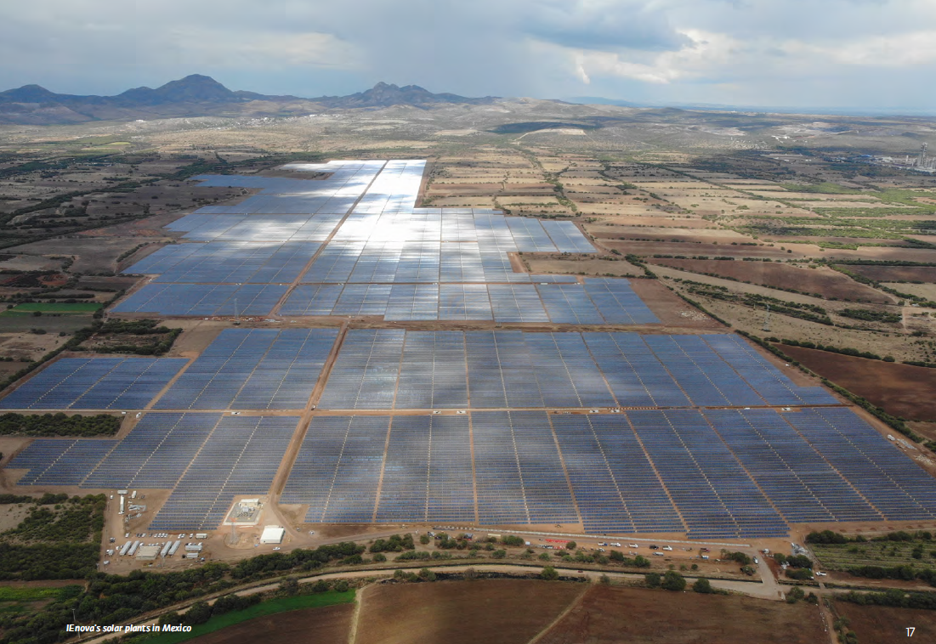
Green loans from IFC: Case example Mexico
2019/2020 | IEnova (Mexico): $541 million
In Mexico, IFC structured and mobilized a $541 million, 15-year Green Loan facility to support Infraestructura Energetica Nova (IEnova). The green loan will finance the construction of five solar plant projects in Mexico with a total installed capacity of 526 MW. These solar projects will displace carbon-intensive thermal generation in the country and eliminate approximately 793,000 tCO2eq per year. By financing IEnova’s first solar power generation projects, IFC is seeking to support IEnova’s transition towards a greener business model. Following IEnova’s adoption of the Green Loan Principles, this investment became the first certified IFC Green Loan in Mexico.

Slide 50
Green loans from IFC: 2020 Loans to projects in China

Slide 51
Green equity
Rapidly growing since COP 26
Using equity to promote sustainable development
Multi- and bilateral financial institutions are revising their policies or positions on equity investing
European Investment Bank is consulting publicly on a new Standard 11 on Intermediated Finance
Asian Development Bank (ADB) is currently reviewing its Energy Policy, which addresses FI investing
International Finance Corporation (IFC) is reviewing its Approach to Greening Equity
Asian Infrastructure Investment Bank(AIIB) will begin a review of its Energy Sector Strategy in December 2021.
GCF has accelerated its support for equity investments, primarily through its Private Sector Facility (PSF). Equity investments, including the most recent approval of GCF equity investment support for two large private equity funds supporting adaptation, make up 22.1% of GCF private sector investments and focus on de-risking private sector climate infrastructure projects and programmes and structuring anchor investments in climate equity/debt funds.
Remark: as equity has “junior” status compared to debt (bonds, loans), investing in green equity is a way to de-risk the debtors

Slide 52
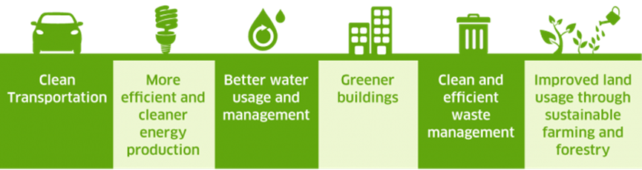
Nasdaq Green equity indexes
Nasdaq OMX Green Economy
Nasdaq OMX Solar
Nasdaq OMX Global Water
Nasdaq OMX U.S. Water
Nasdaq OMX Wind

Slide 53
How to engineer catalytic effects of public investment
Example of a catalytic fund: Catalytic Capital Consortium (2019) https://www.macfound.org/programs/catalytic-capital-consortium/ :The Catalytic Capital Consortium, or C3, aims to demonstrate the power of this form of investment to extend and deepen the reach of the impact investing field, helping to address the annual funding shortfall of $5 trillion to $7 trillion that is hindering the world from reaching the UN Sustainable Development Goals.
IEA Sustainable Recovery Plan2021 – 2023: increase global investment in clean energy by about USD 1 trillion per year over three years, equivalent to 0.7% of global GDP in 2019, 70% from the private sector, 30% from public sources.
Public investors (foundations, high net-worth individuals, government and development finance
institutions) to invest in so-called catalytic first-loss capital (subordinate categories of debt):
Grants, incl. to cover a set amount of first loss
Equity: the most junior equity position in the overall capital structure
Guarantees: A guarantee to cover a set amount of first-loss capital; is like a grant but has a cost.
Junior subordinated debt: The most junior debt position in a company
In doing so, the public sector de-risks senior categories of debt or equity
This helps attracting low-risk investors

Slide 54
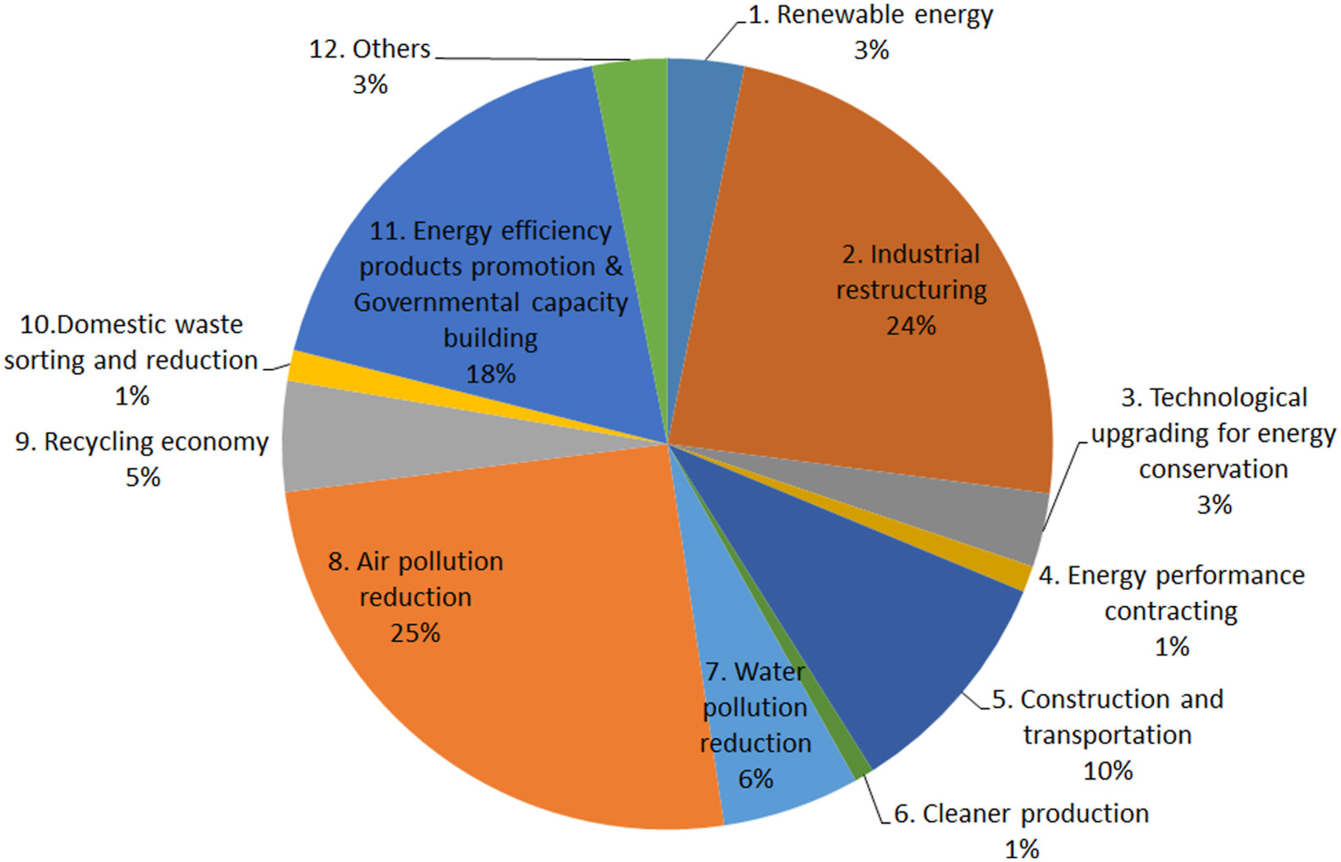
Example of catalytic funding for cities: Shanghai
Financing urban low-carbon transition: Peng & Bai: The catalytic role of a city-level special fund in Shanghai, Feb 2021
https://doi.org/10.1016/j.jclepro.2020.124514
Shanghai special fund for energy conservation and emission reduction
Analysed 12 policy domains, consisting of 41 subsidy policies, 167 subsidized projects. Scope of the study: how allocated fund are used to enable low carbon transition

Slide 55
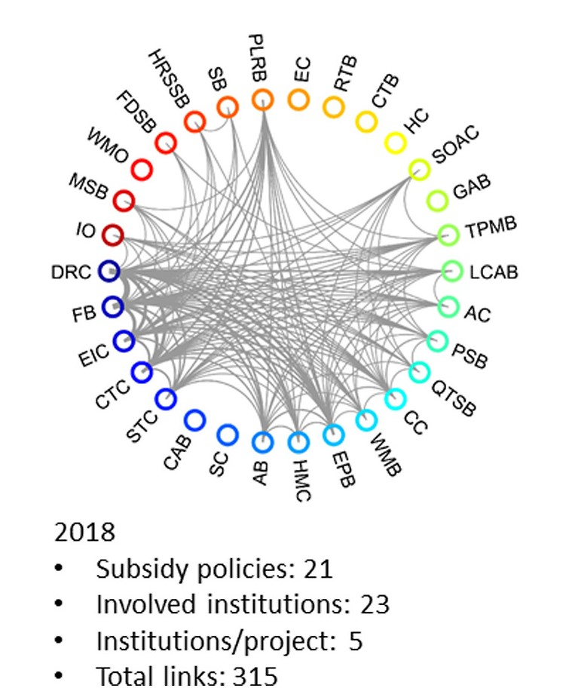
Results of the analysis
A linkage analysis is applied to understand the effectiveness of this scheme in enabling collaboration between institutions.
The direct results of Shanghai’s special fund scheme include carbon reduction outcome and a variety of tangible capacity building activities, such as data reporting systems and demonstration projects
The fund plays a catalytic role in enabling coordination and collaboration across different government departments on cross-cutting policy domains
The special fund may have enabled local capacity building in multiple ways, through financing the governmental capacity building, incentivizing engagement from other stakeholders, and raising public awareness
The study also shows that a well-designed, city-level direct fund scheme can fill an implementation gap between the policy outputs and the policy outcomes

Slide 56
Economic Measures Available to Cities
Conclusions
What is the Energy Transition
How to Catalyze Public Investments

Slide 57
Main take-aways (1)
Technically, the 1.5-degree goal can still be reached, but only a narrow pathway with around 400 milestones can lead to this goal
Global investment gap huge (quadruple global annual investment)
In emerging and developing economies: six-fold increase; huge benefit as costs in developing and emerging economies are less than half of costs in advanced economies
Role of public investment to be increased; more equity, less debt
Measures must be taken to 1) diminish the risks and 2) increase the returns and profitability of green investments
Main economic instrument: set a carbon price, either by means of a carbon tax, or by means of an emission trading scheme (ETS).
Accelerate the phase-out of fossil subsidies, phase-in of RE support

Slide 58
Main take-aways (2)
Economic support measures: FITs, RECs/GOs, PPAs
Cities to use all of them, depending on their powers
Instrument of choice: PPPs combined with PPAs to promote local objectives (renewables share, portfolio standards, GPP, ESG)
Financial instruments:
  Guarantees (still waiting for a global de-risking guarantee announced by the ISA)
  Green bonds: developing rapidly; cities have used them; > US$ 1 trl
  Green loans: examples by IFC in China and Mexico
  Green equity: Trendy after COP26
How to catalyse public investment. IEA: 30/70 public-private proportion
  Example of Shanghai

Slide 59

THANK YOU
FOR YOUR
ATTENTION！
“Joining Hands Toward Sustainable Energy Development in the Asia-Pacific Region.”

